Slide 1
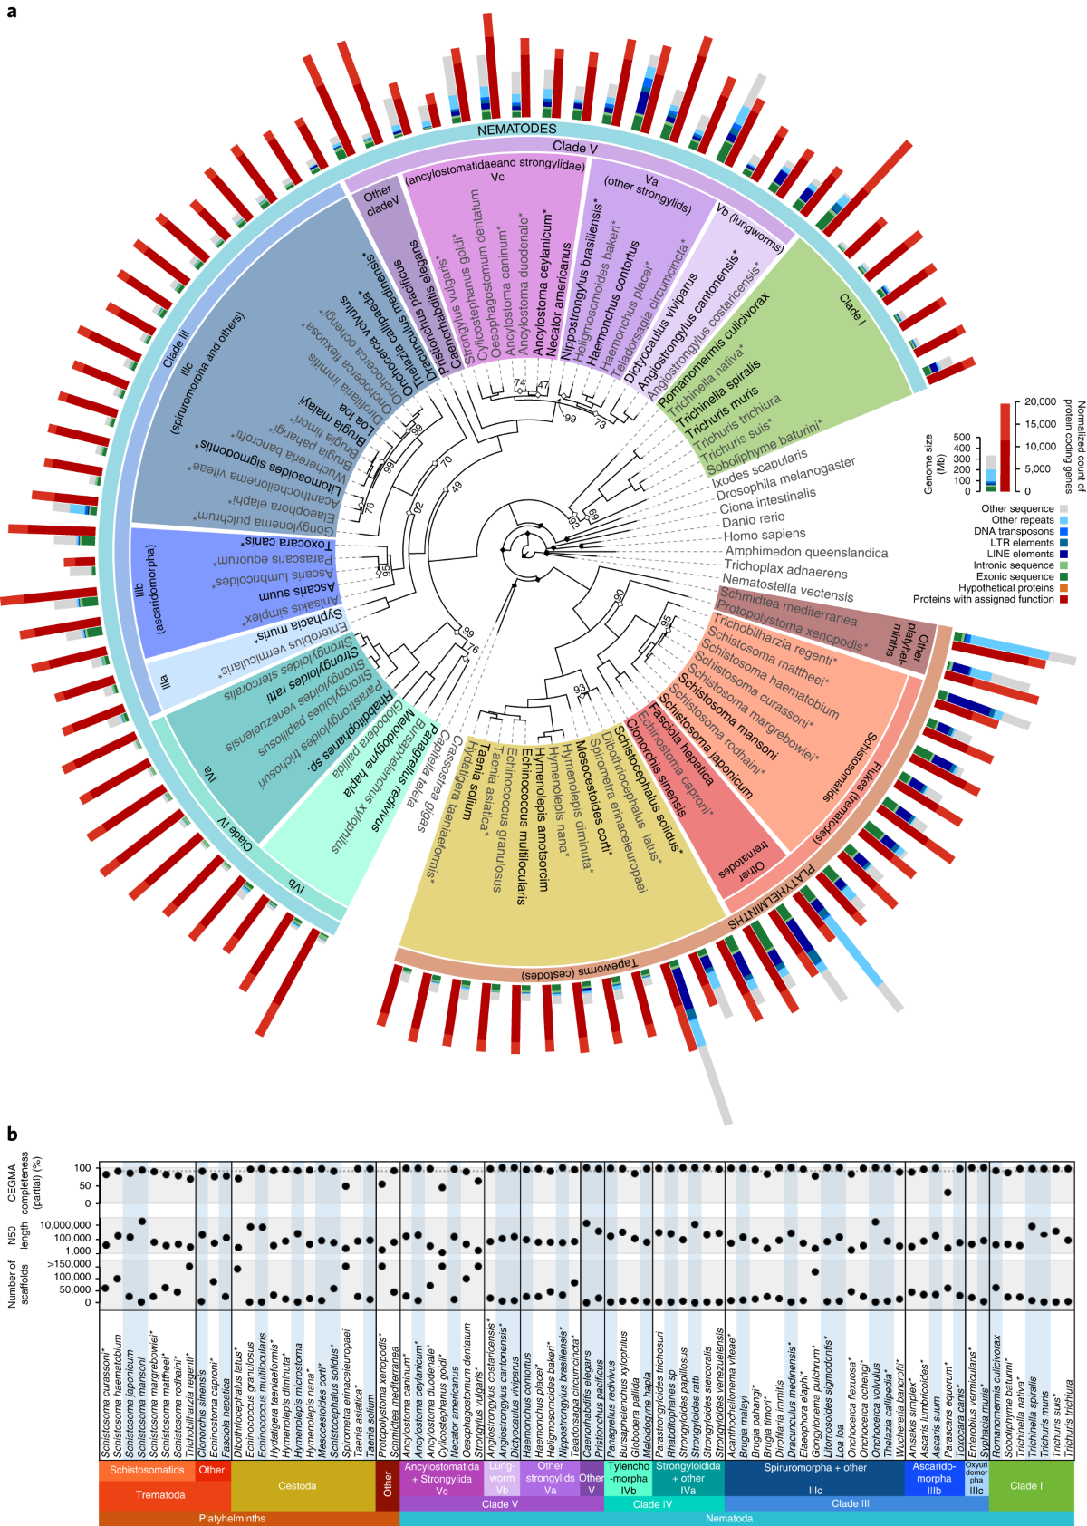




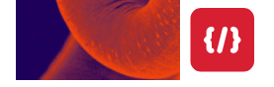
Part 1
parasite-help@wormbase.org
Helminth Bioinformatics

Slide 2
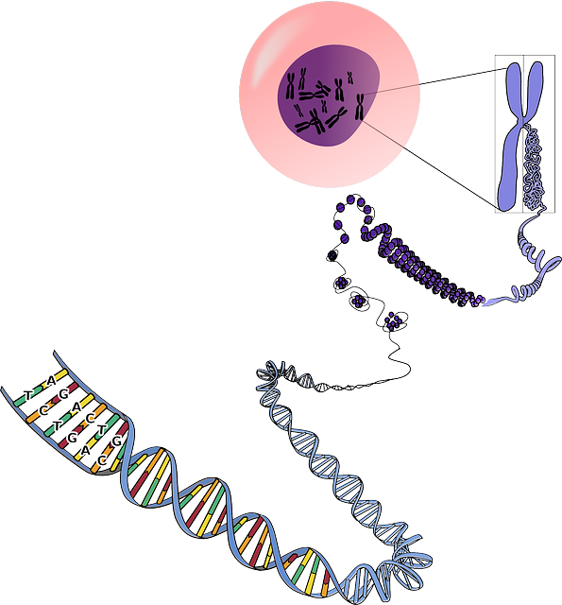

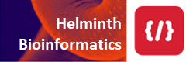
Genome
A genome is an organism’s complete set of genetic material.
Although every individual’s genome is unique
2

Slide 3
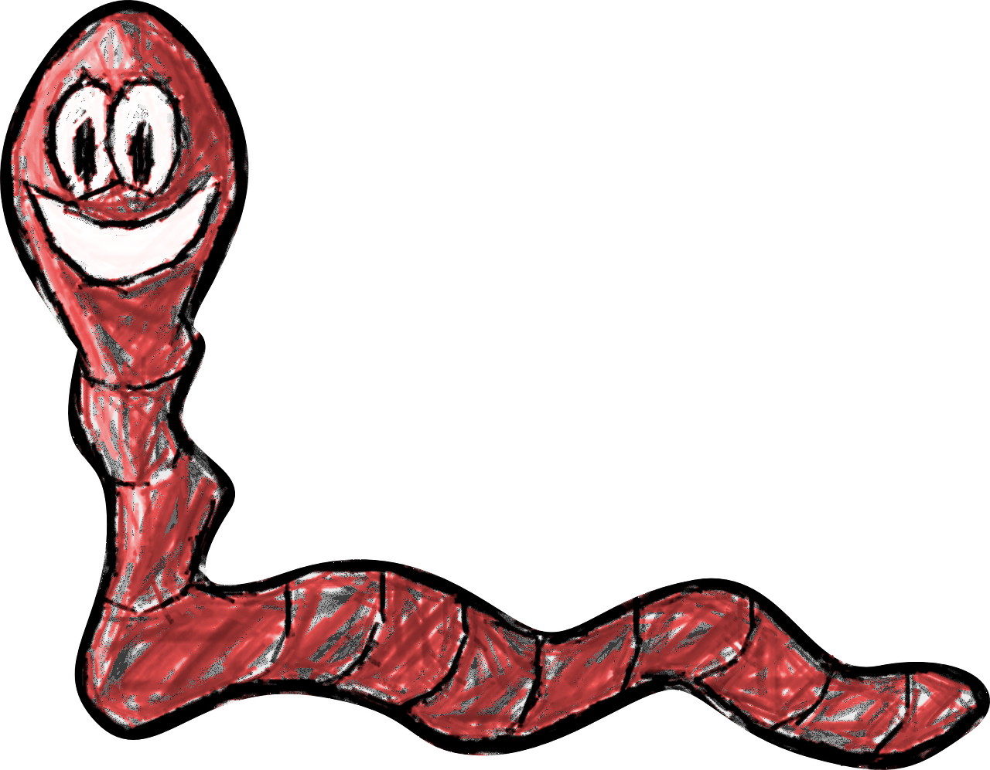



Genome
A genome is an organism’s complete set of genetic material.
The genomes of individuals of the same species will be very similar!
3

Slide 4
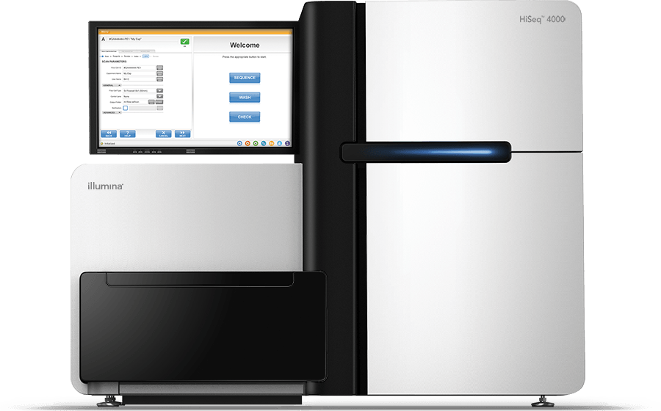
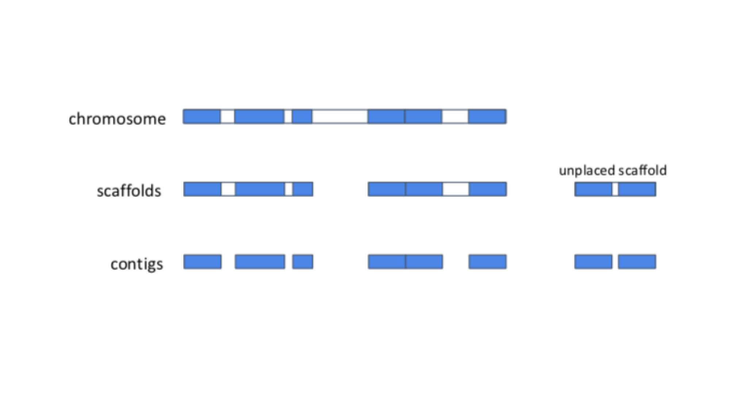
Genome
It is useful to have a representative genome sequence for each species:
Reference genome
DNA Sequencing
Genome assembly
We use the technique of sequencing shorter segments of chromosomes and piece them together like puzzle!
The genomes of individuals of the same species will be very similar!
4

Slide 5
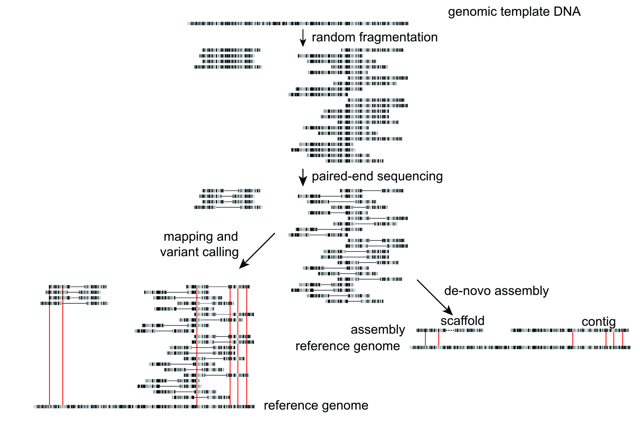
Simplified genomics workflow
Sample / library preparation
Sequencing
Informatics
5

Slide 6
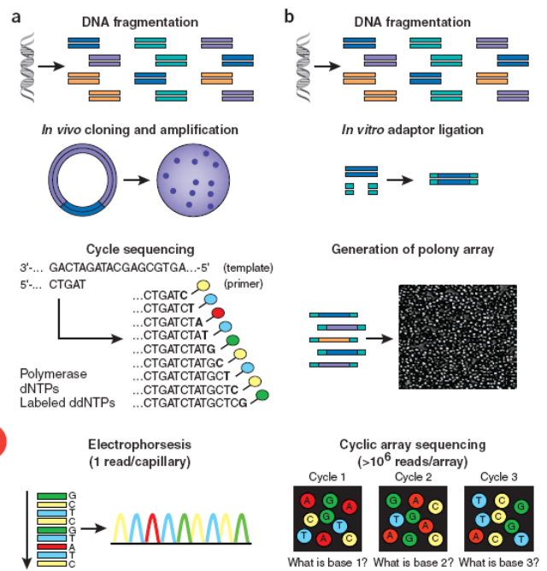
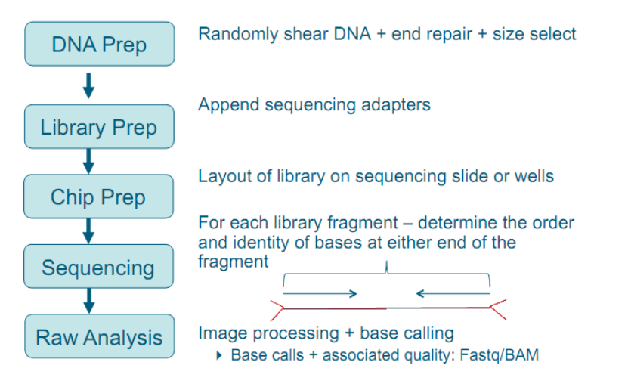

Generating Genome data
6

Slide 7
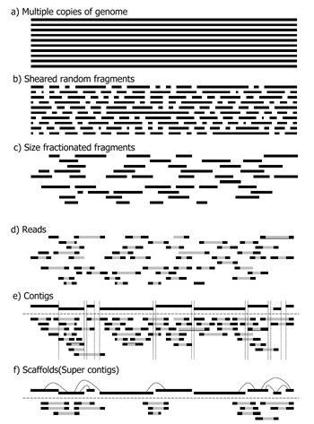
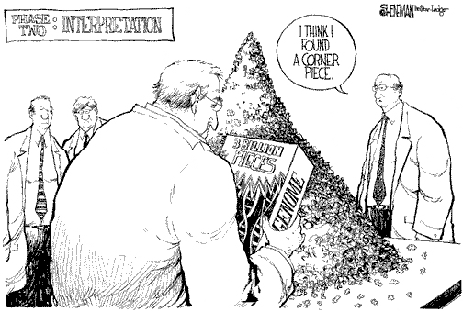
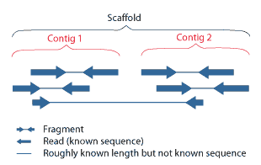
Assembly: reconstructing genomes
definitions
7

Slide 8
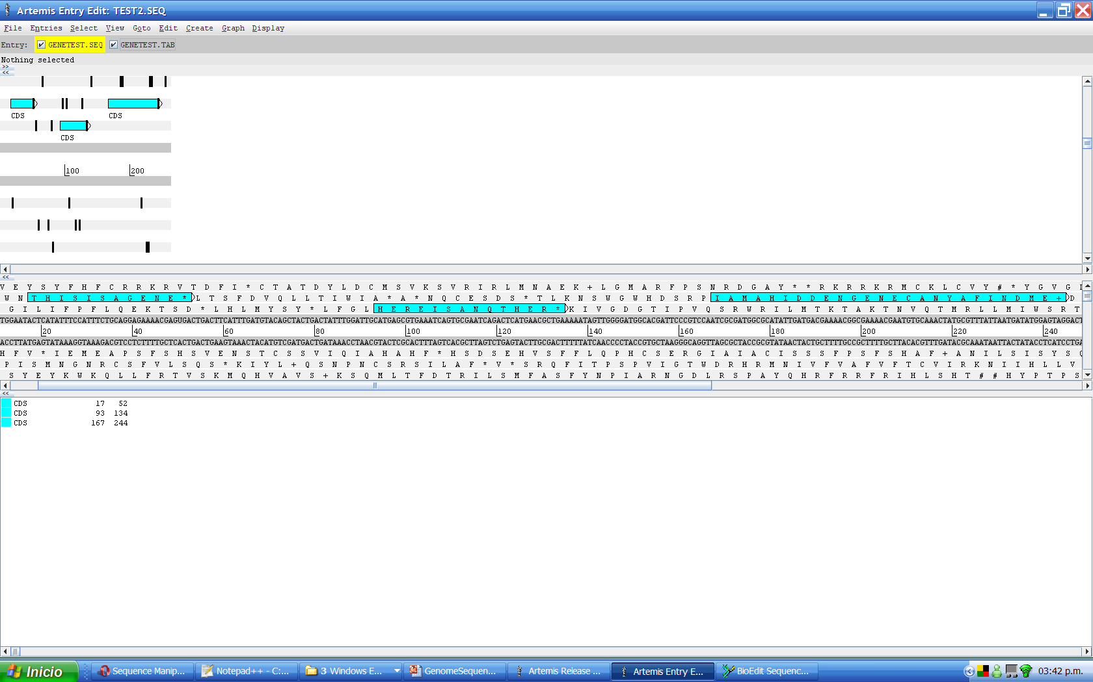
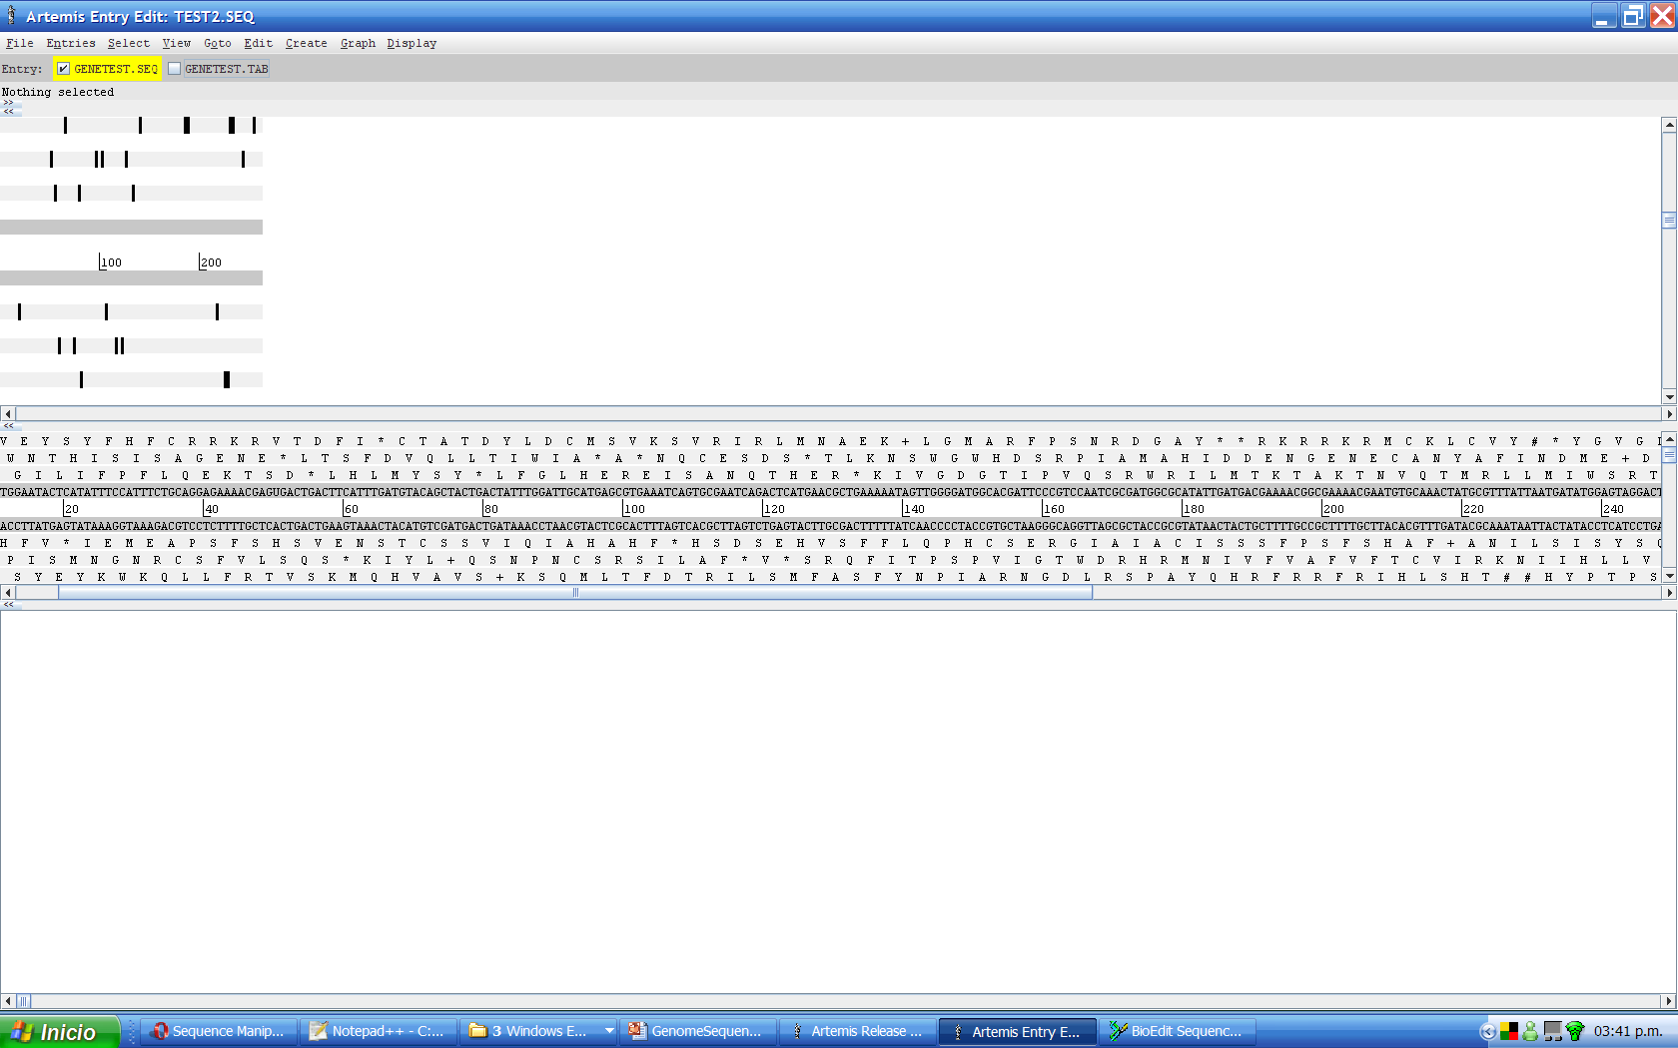
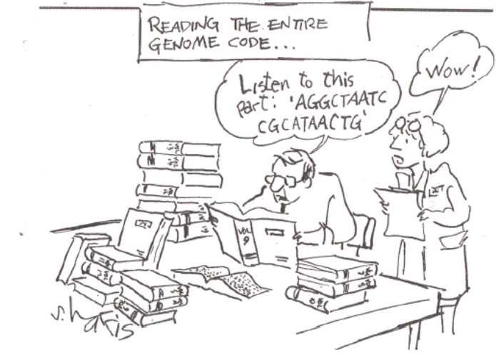
Annotation: making sense of sequences
What is a gene ?
where are the genes ?
Finding patterns in sequences
Finding patterns
8

Slide 9
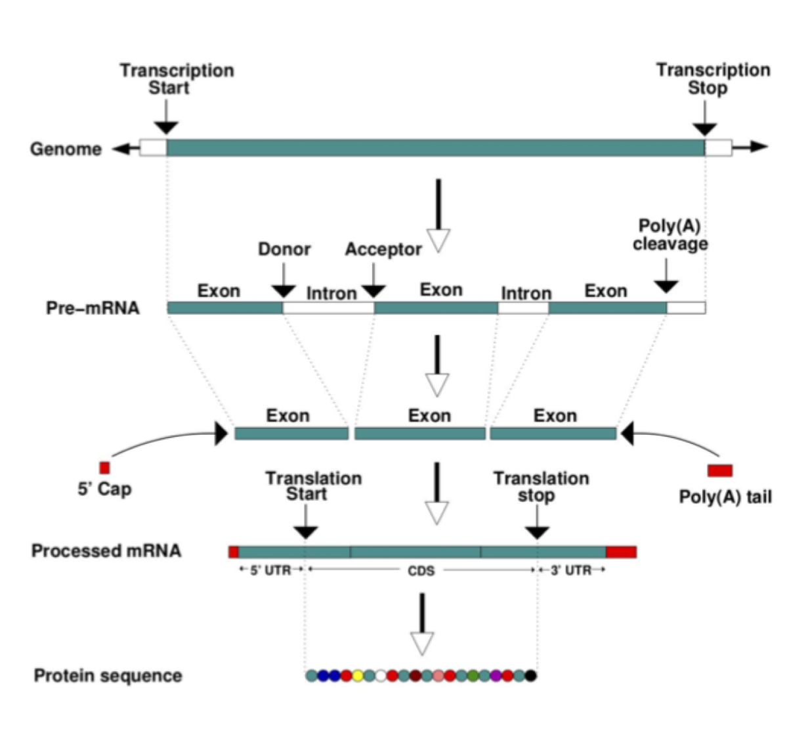
Genes: the basics
A gene is a unit of the genome, a DNA sequence, that is transcribed into an RNA molecule, or a transcript.
A gene can have multiple transcripts!
9

Slide 10
Annotation approaches
Sequence
Composition analysis
6 frame translation
ORF & CDS finding
Similarity search
Alignment to mRNA, ESTs, protein data
(evidence based)
Ab initio gene prediction
Pattern search in sequences
Gene finding software
(predictive )
Comparative methods
Database search and results alignment
to related genomes or genes
(suggestive)
Refining
training set
Accurately predict
sample set of genes
Full gene set
(upgradable)
10

Slide 11
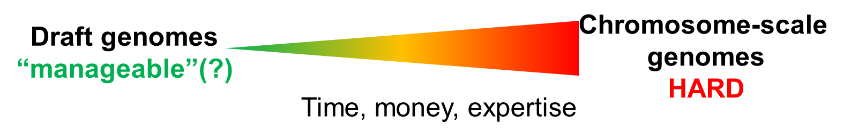
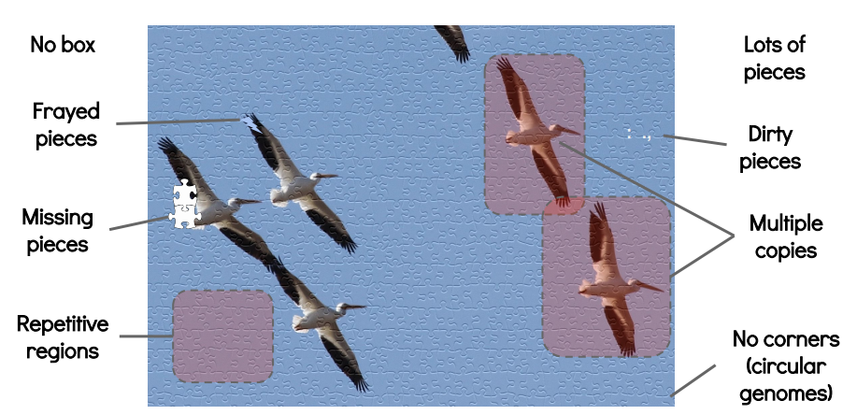
Not all genomes are created equally
Genome: biologically
“the haploid set of chromosomes in a gamete or microorganism, or in each cell of a multicellular organism”
“the complete set of genes or genetic material present in a cell or organism”
Genome: bioinformatically
Best guess, but often:
highly fragmented
misassembled to some degree
Haplotypic
contaminated
duplicated or missing
Adapted from S. Doyle presentation: “genome assembly”
11

Slide 12
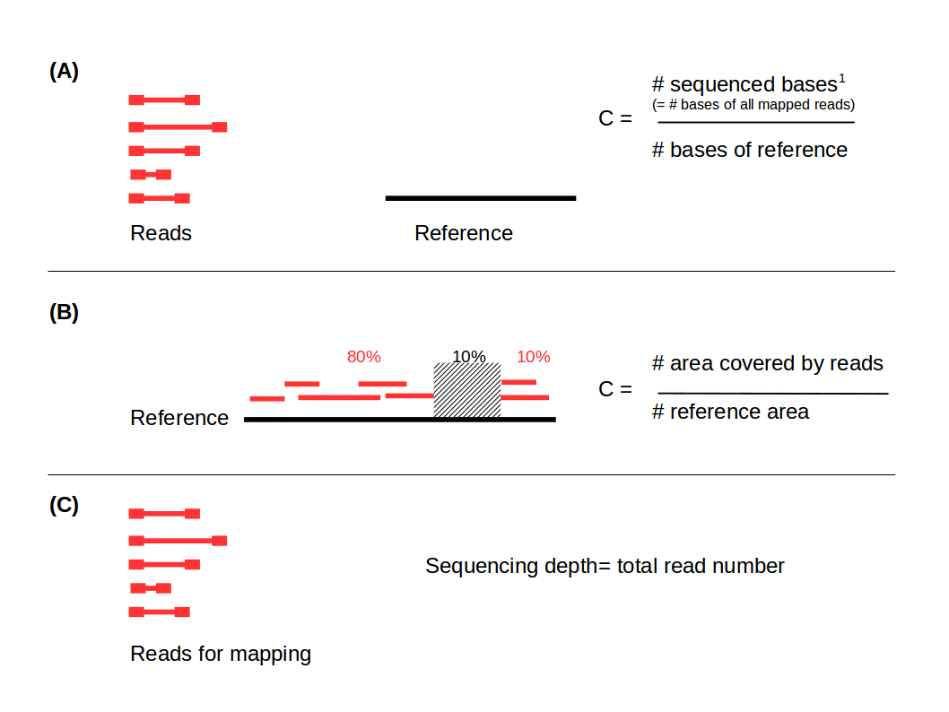
Genome Quality Statistics
Sequencing depth: refers to number of times a particular nucleotide is read during the sequencing process. Typically expressed as a multiple (30X)
Sequence coverage, refers to the percentage of a genome sequenced at least once.
12

Slide 13
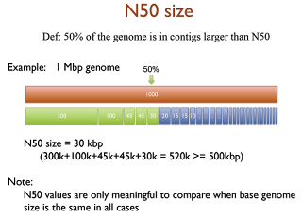
Genome Quality Statistics
Contiguity describes how many scaffolds a genome is represented by:
in a perfectly contiguous reference genome, the number of scaffolds would be equal to the number of chromosomes.
Typically expressed as N50, the length of the shortest contig in the longest group of contigs that together represent at least 50% of the total genome sequence length.
13

Slide 14
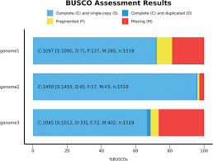
Genome Quality Statistics
Completeness:
BUSCO
(Benchmarking Universal Single-Copy Orthologs) is a method of assessing genome completeness.
Detection of a set of highly conserved genes that
should be present in single copy.
A higher percentage of single BUSCO genes, indicates a higher quality assembly.
BUSCO ASSEMBLY
prediction of a set of conserved genes
BUSCO ANNOTATION
14

Slide 15

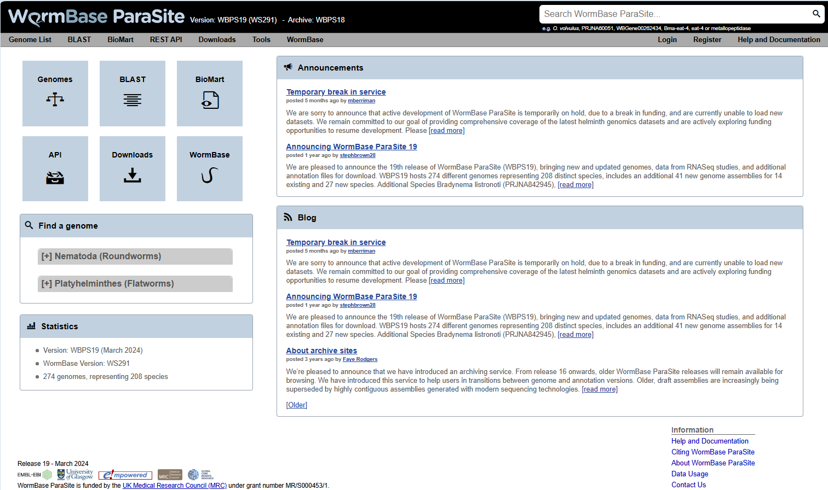
2014
Release
Species
Genomes
1
82
82
2024
Release
Species
Genomes
19
208
274
parasite.wormbase.org
15

Slide 16
Usage Statistics (2023)
Annual Users
Page Views
Twitter Followers
17,000
350,000
1,903
Top Accessing Countries
parasite.wormbase.org
1. USA, 2. China, 3. UK, 4. Germany, 5. India
16

Slide 17

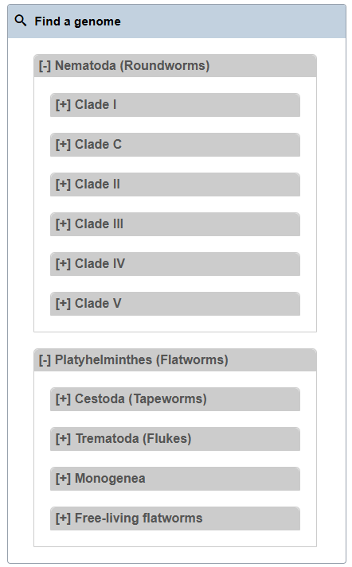
159 205
18 26
7 7
4 4
25 32
40 59
65 42+36= 78
Species& Genomes Distribution
49 69
16 20
28 41
3 3
2 5
parasite.wormbase.org
17

Slide 18
How to submit a genome to WormBase ParaSite?
1. Submit your genome to an INSDC Sequence database (ENA, NCBI or DDBJ)
Reference genome
2. Contact WormBase ParaSite once submitted
Genomes
Genome assembly
3. Send us the gene model annotation file in GFF3 file format
parasite-help@wormbase.org
18

Slide 19

WBPS adds value to genomes
Processing &annalyze
adding value to the genomes!
Compara
Repeat Modeler
BUSCO score calculation
DNA features
RNA features
Analysis descriptions
Xrefs
GPAD load
Core statistics
Protein features
FIle dumps
BioMart
Gene expression studies
Jbrowse
AlphaFold
And then we make them accessible to you!
Genomes
19

Slide 20
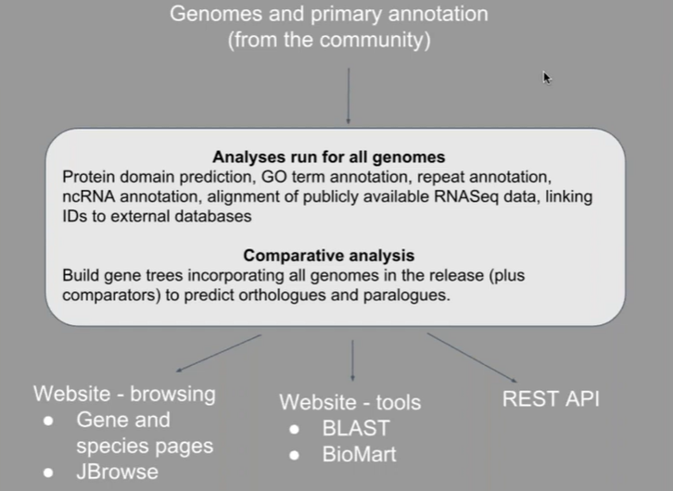
pipeline
20

Slide 21
Gene and transcript information
Gene page
Transcript page
21

Slide 22
Functional annotation
what does the encoded protein do?
22

Slide 23
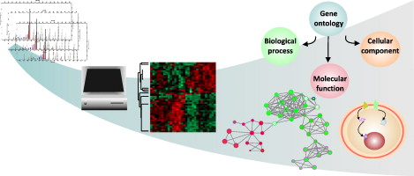
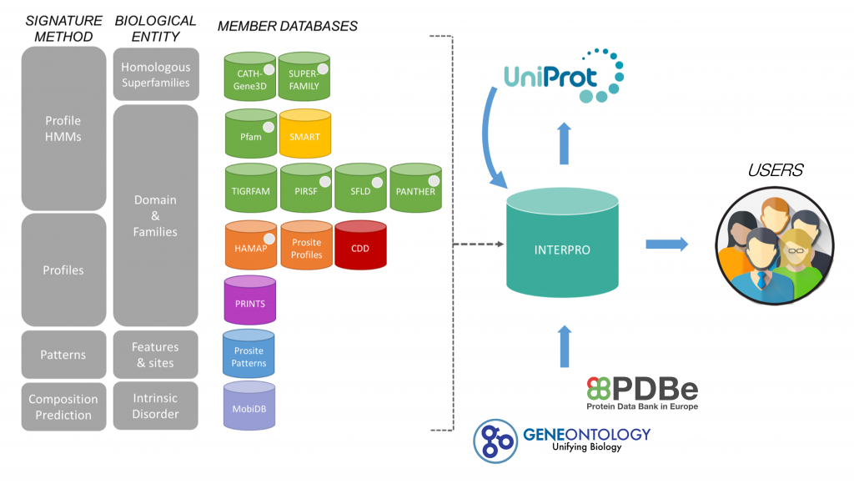
Functional annotation
Gene ontology
knowledge about a gene with
respect to three aspects:
Molecular Function
Cellular Component
Biological Process
what does the ecoded protein do?
Interpro :
Domains & features
Classifying proteins into families and predicting the presence of domains and important sites..”
23

Slide 24
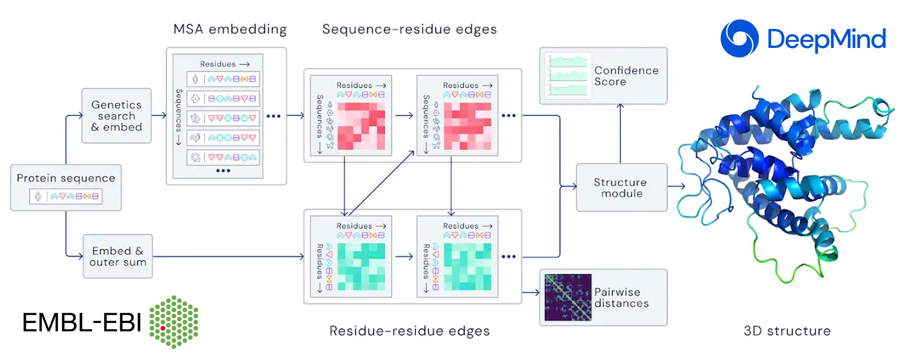
Functional annotation
STRUCTURE PREDICTION
3D structure is a huge hint for understanding how the protein works
Structure can help in :
Predicting interactions to ligands
Docking simulation
Predicting mutation effects
Structure alignment with similar proteins
AlphaFold
https://alphafold.ebi.ac.uk/
Computational prediction of protein structures with unprecedented accuracy and speed.
24
Notes:
SwissDock, a web service to predict the molecular interactions that may occur between a target protein and a small molecule. It is used alongside S3DB, a database of manually curated target and ligand structures, inspired by the Ligand-Protein Database.
Zhang group Online-serivces portal
Docking simulations (https://zhanggroup.org/EDock/) against different ligands.
Protein structure alignment with another protein (https://zhanggroup.org/TM-align/).

Slide 25
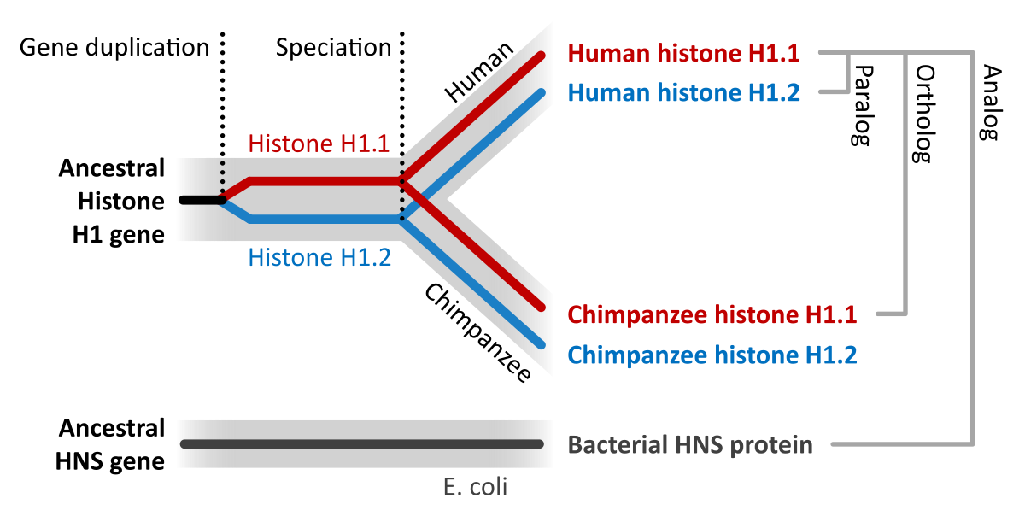
Comparative Genomics
ORTHOLOGUES & PARALOGUES
Comparative genomes and genome evolution
Are proteins similar to the one I am studying in other organisms?
What do they do?
there similar proteins of thetWhy would researchers want to find orthologues in other species for their gene of interest?
Functional Annotation! If the function of this gene in S. mansoni is not known, you can check the function of its orthologues genes in other species like C. elegans or other Schistosomes. Many times you will find that orthologous genes function will be similar to this of your gene of interest.
25

Slide 26
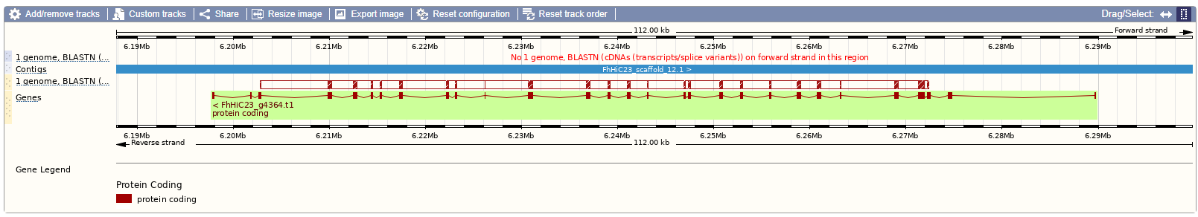
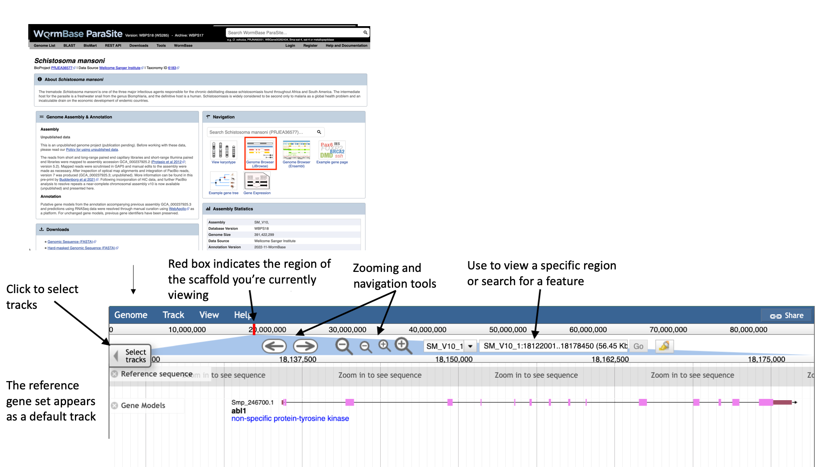
Today module
Overview and aims
Familiarize with the WBPS
Browsing genomes
Browsing gene/transcript pages
Browsing with Jbrowse
26

Slide 27
Today module tools
Data Retrieval (BIOMART)
BLAST Homology search
VEP variant expression
Expression Browser & gProfiler
27

Slide 28
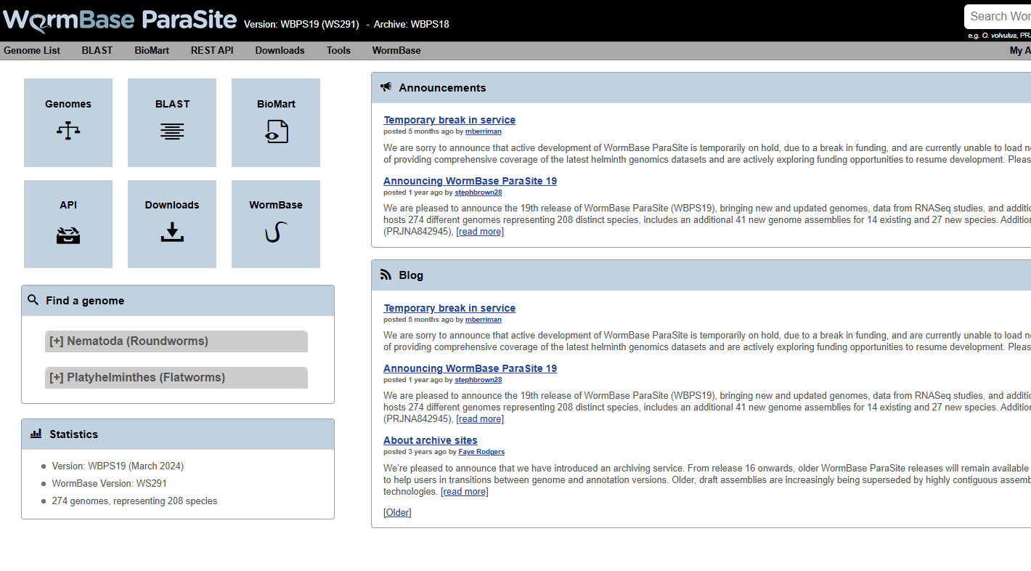
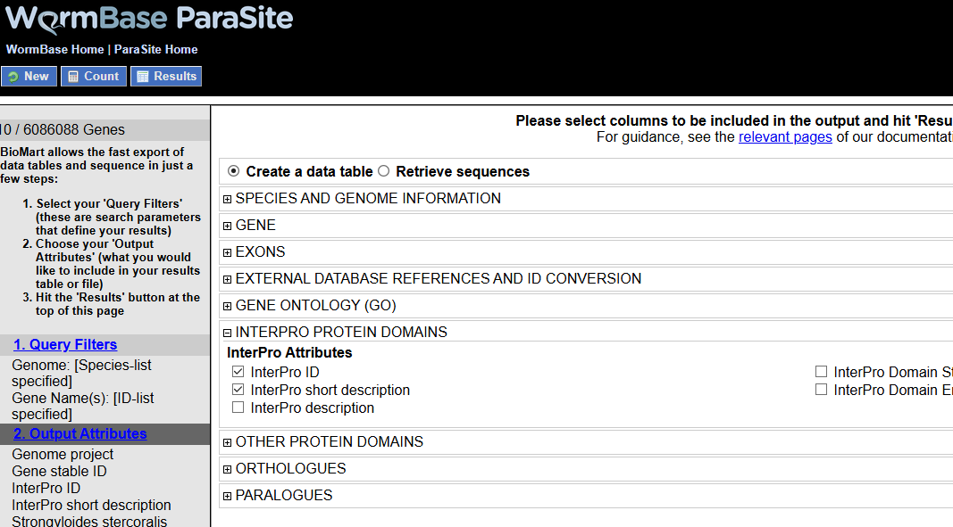
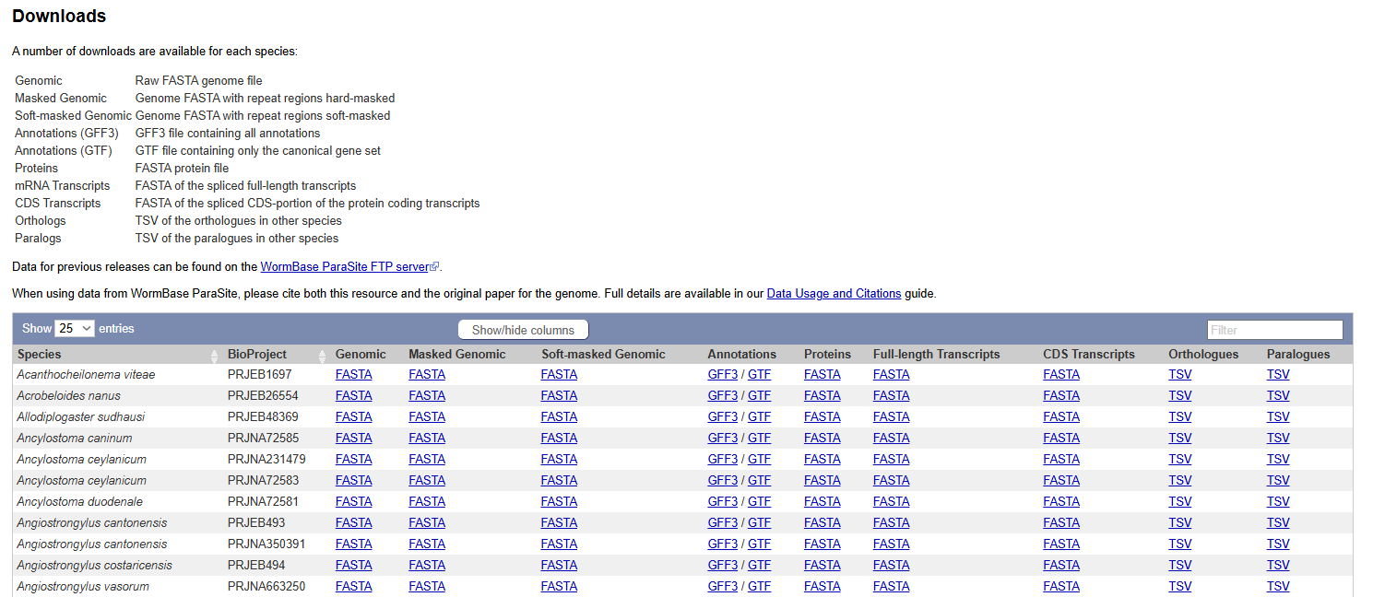
Data retrieval
genome whole datasets
Build complex queries
28

Slide 29
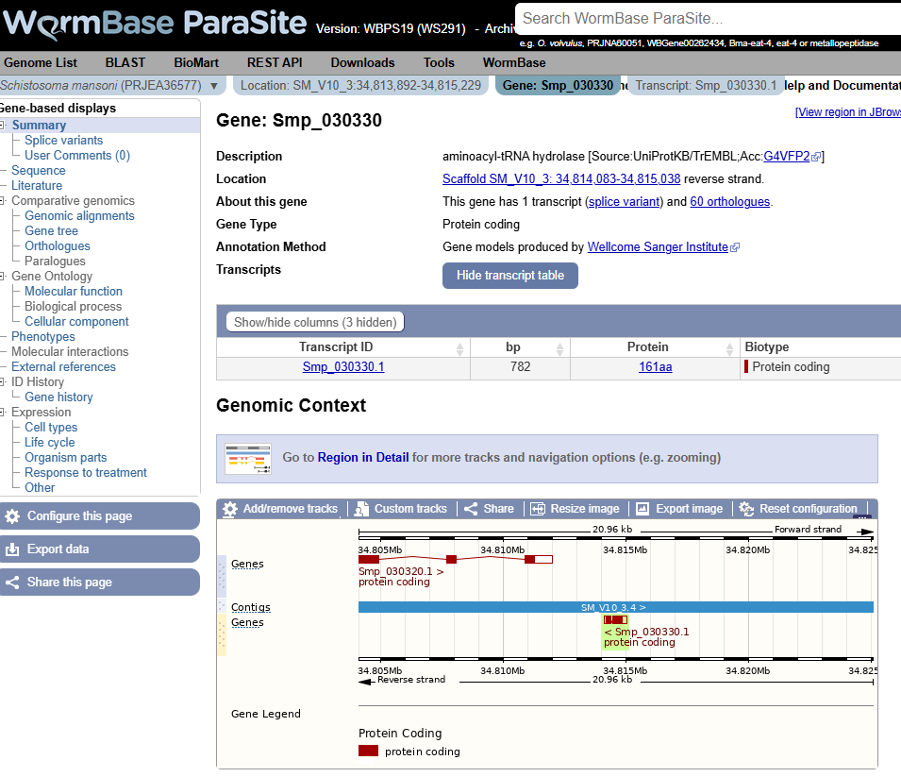
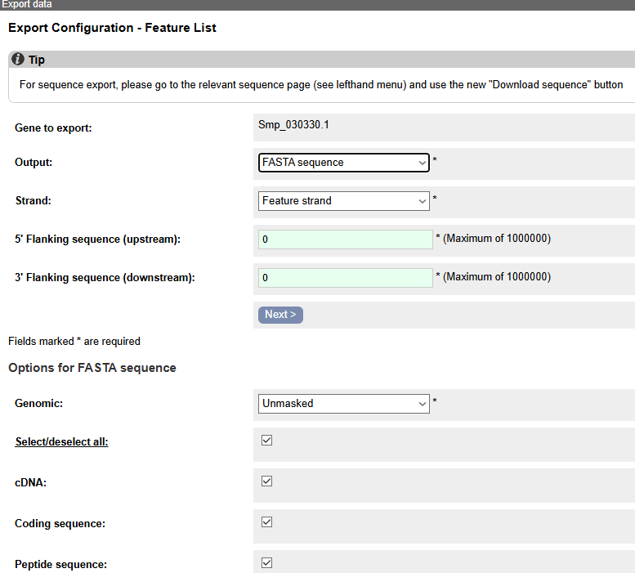
Data retrieval
gene or region
datasets
..or images
29

Slide 30
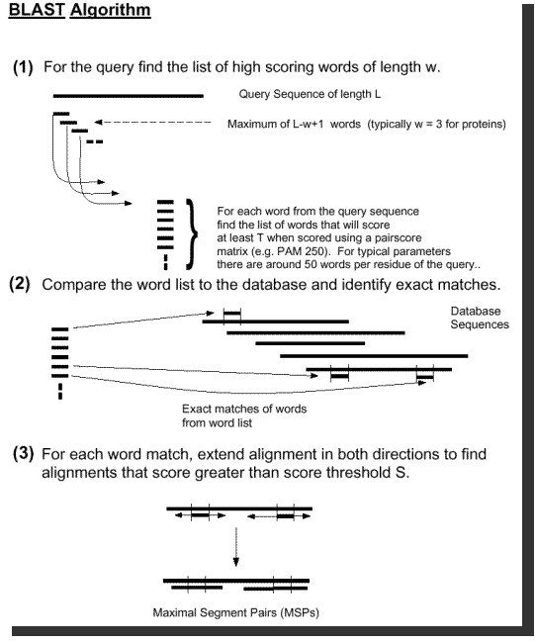
BLAST Homology Search
Chop query in “words”
Find exact matches
Extend & report if
over threshold
30

Slide 31
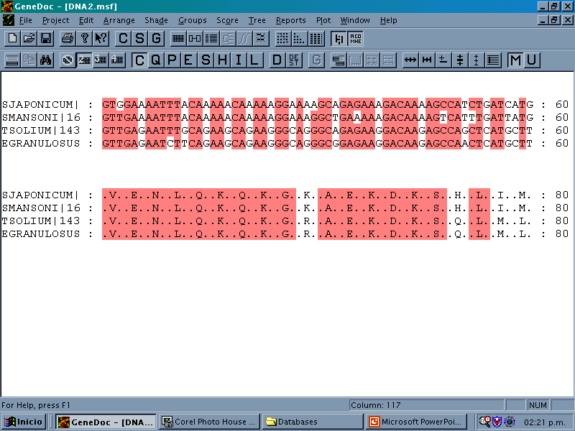
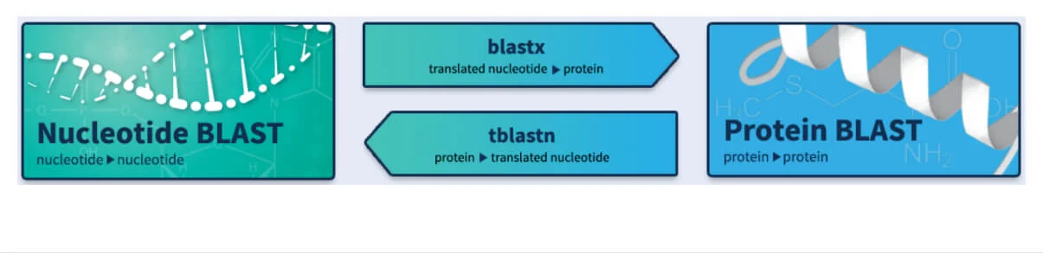
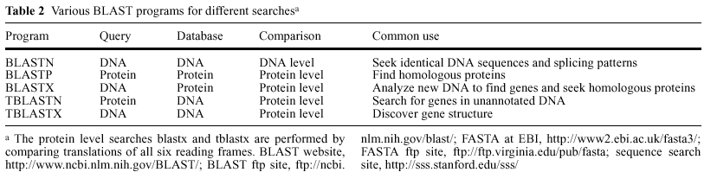
BLAST Flavours
31

Slide 32
BLAST Homology Search
32

Slide 33
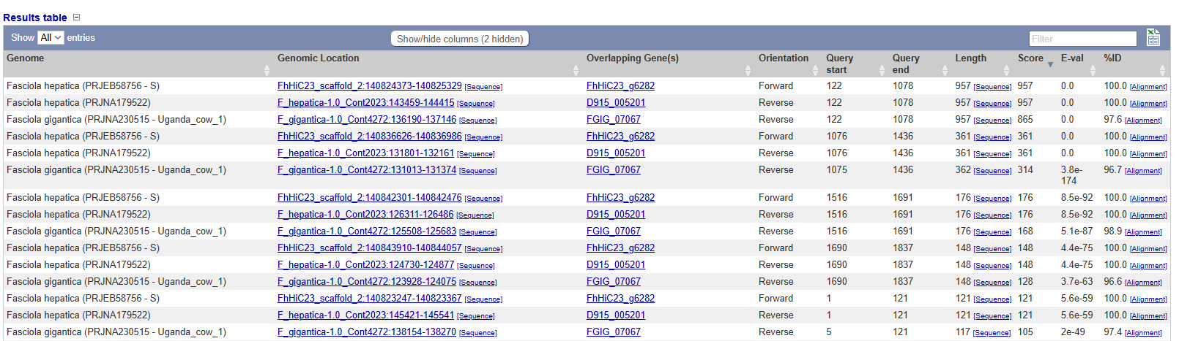
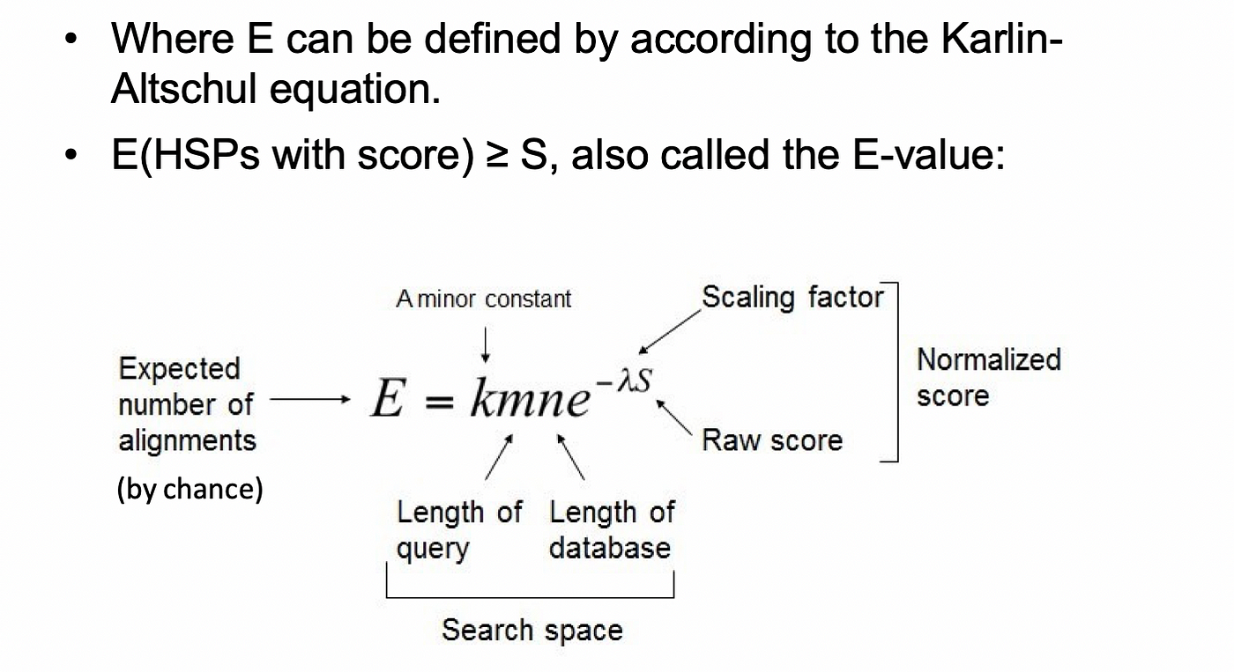
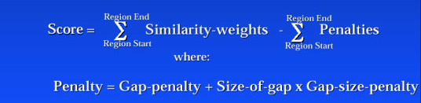
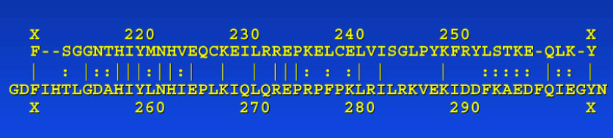
BLAST Metrics
E-value
Statistical significance of alignment
Probability of being by chance
Score
Giving weight to
similarities and penalties
Identity &
similarity
33

Slide 34
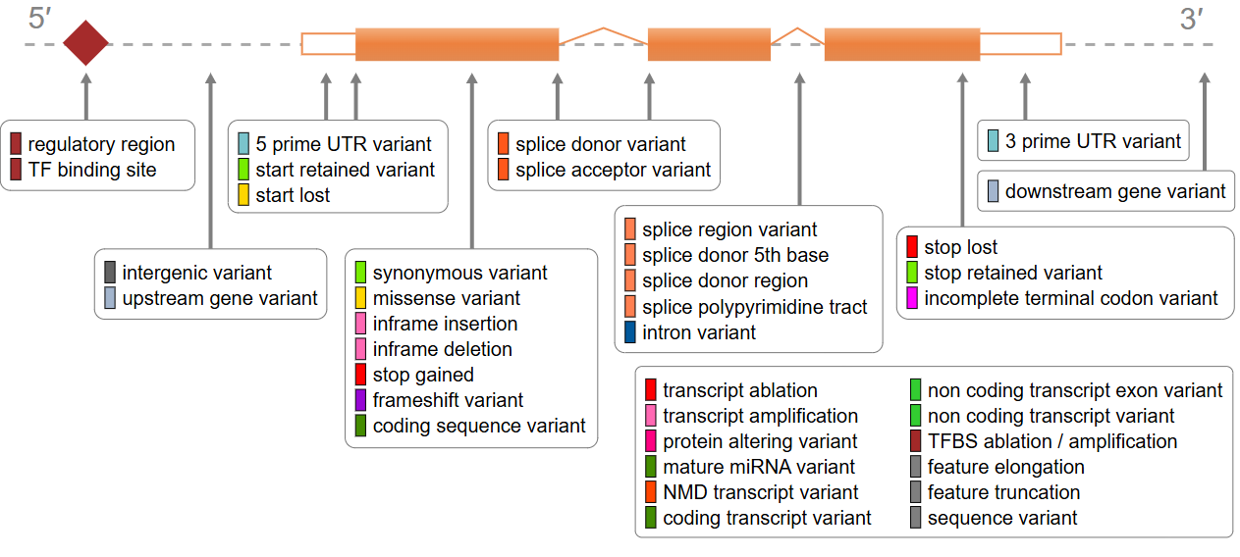

Variant Effect Predictor
allows you to predict what the consequences of variants found in a genome
whether they fall within or near genes
whether they result in a change to the amino acid sequence of a protein
whether the resulted change is predicted to have a severe impact on the protein
34

Slide 35
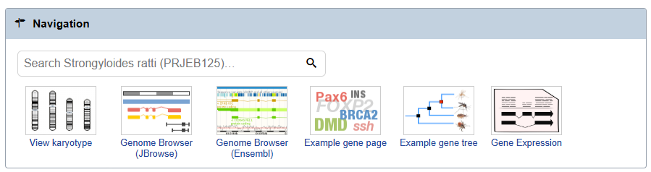
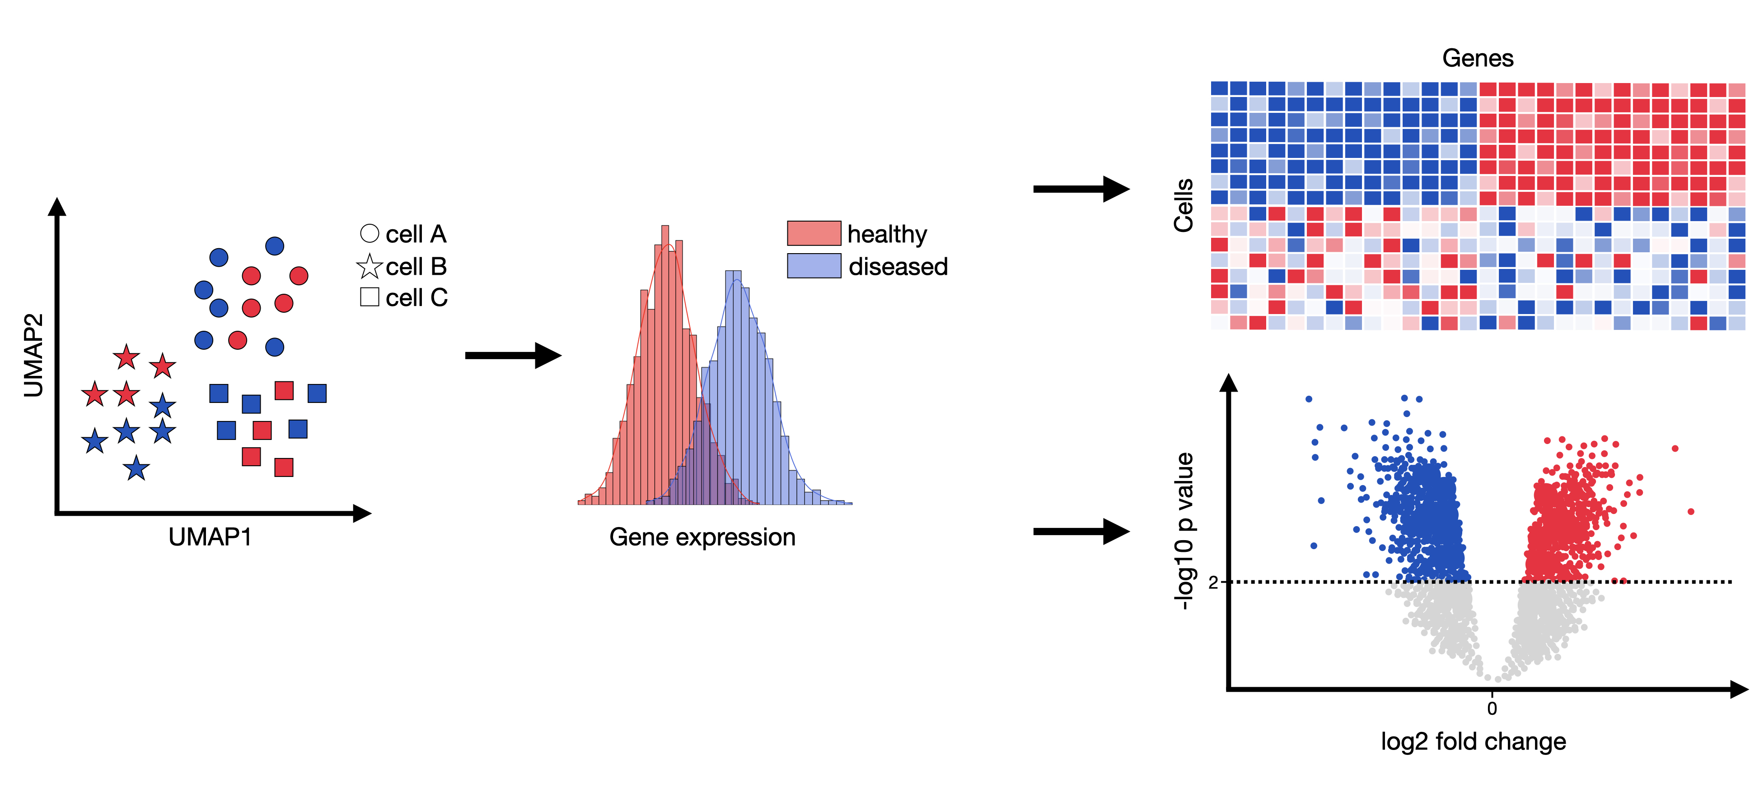
Gene Expression Browser
WormBase ParaSite has collated RNAseq data from publicly available studies and analysed it against our genomes and annotations
You can look up pre-calculated differentially expressed genes.
35

Slide 36

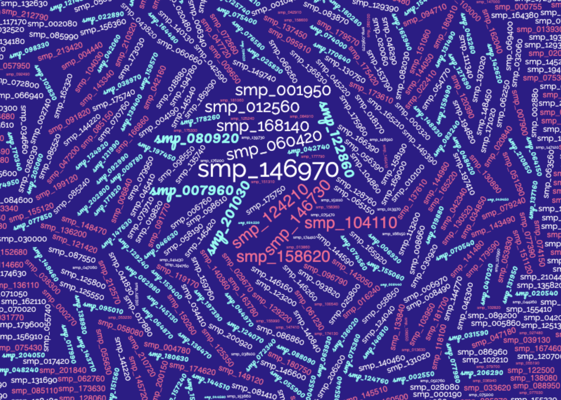
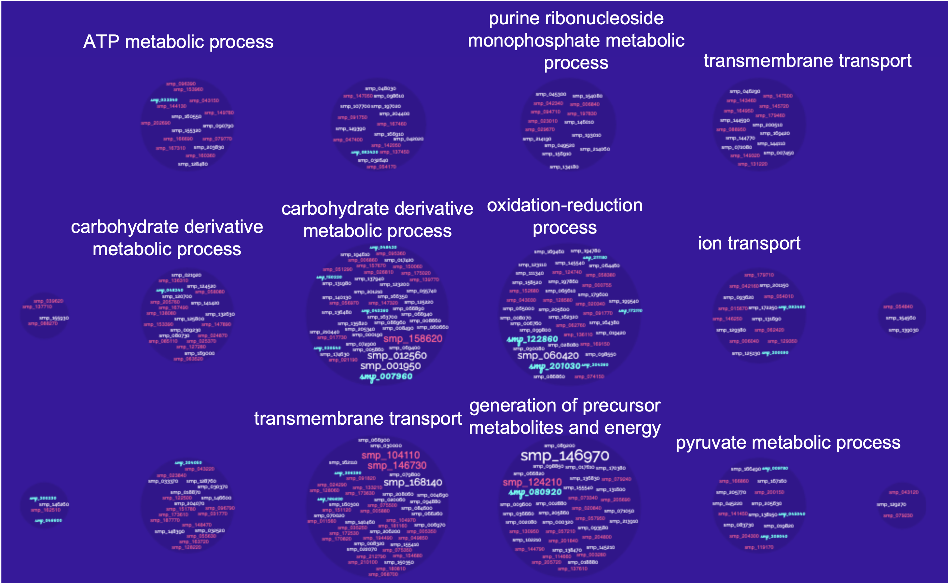
Gene-set Enrichment Analysis
method used to identify biologically meaningful groups of genes that are collectively up- or down-regulated in a given dataset.
Clustering the genes in gene onthologies and performs statistical tests to select those significant.
36

